Slide 1
CUMBERLAND PLAIN CONSERVATION PLAN
Implications for Western Sydney and Australia

Slide 2
OUTLINE
What is the CPCP really about?
Impacts – region by region
Offsets/Compensation
Effective Action
We will email this presentation & other resources to the group

Slide 3
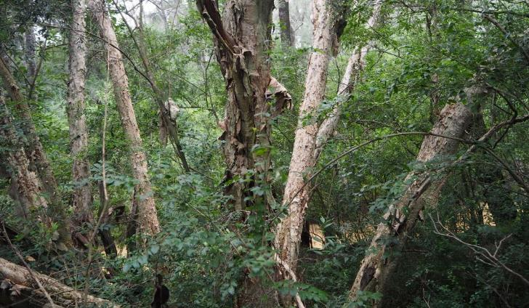
Respecting Country
Gundungurra, Darkinjung, Dharawal & Darug country

Slide 4
Understanding the CPCP
All the business in one package
Will the CPCP approach be better than dealing with these individually?
Development approval plan
Development component
Compensation or ‘offset’ component
Deals only with Biodiversity approvals
But locks in outcomes through design
Traffic
European & Aboriginal Heritage
Urban Heat Island – Appin & Luddenham to reach 50ºC

Slide 5
SCALE OF CONSEQUENCE
Development – regional impact
Offsets – regional impact
Approval Approach – national impact

Slide 6
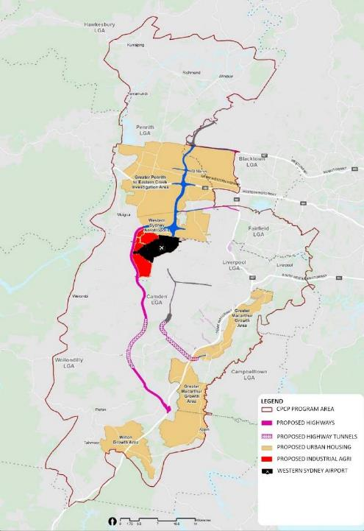

Slide 8
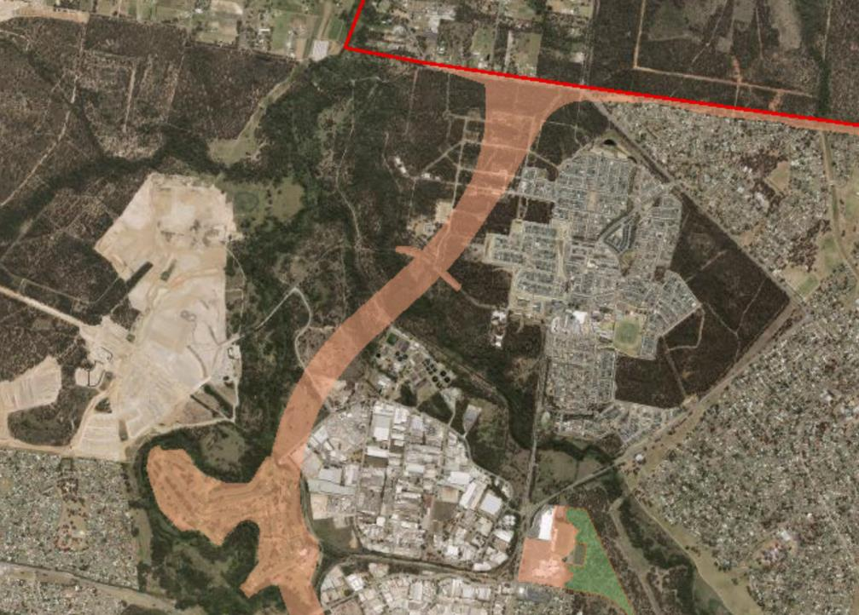

Slide 9
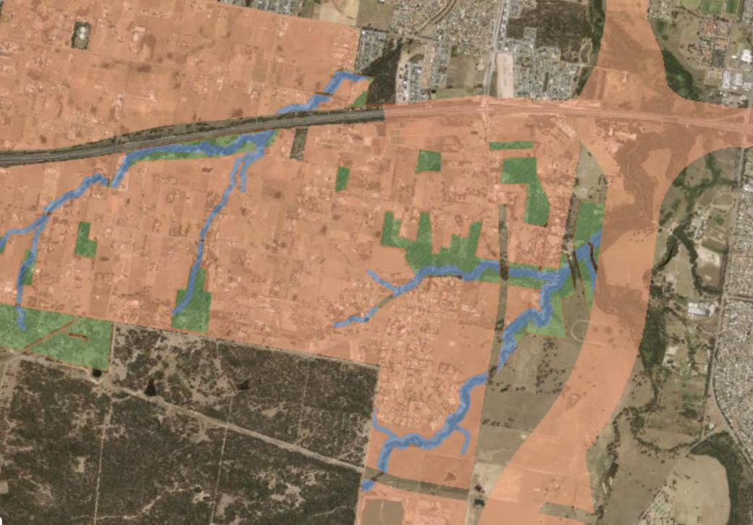

Slide 16
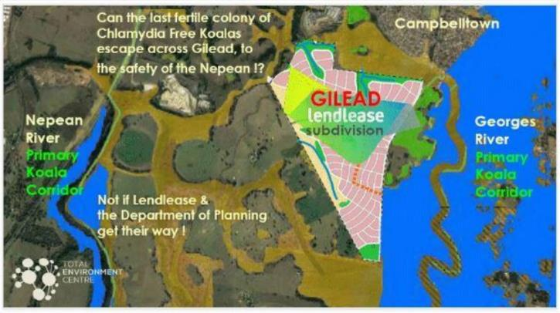
Impacts on Campbelltown koalas
Biggest impact isn’t assessed - stopping the current recolonization of koalas from their historic refuge in Wedderburn across the vast Cumberland Plain to the west

Slide 17
‘Avoidance’ (E2 zoning)
Existing Office of Water VRZ (‘non-certified’) - creeklines
Proposed Environmental Conservation Zoning (E2)
Buffers to VRZ
Mostly undevelopable
Small lots zoned E2 while concurrently excluded offset funding (Chase/Haven)
WS Growth Centres showed this approach failed to protect vegetation – vast clearing
No support for landowners
False benefit – model is known to fail landowners and the environment

Slide 18
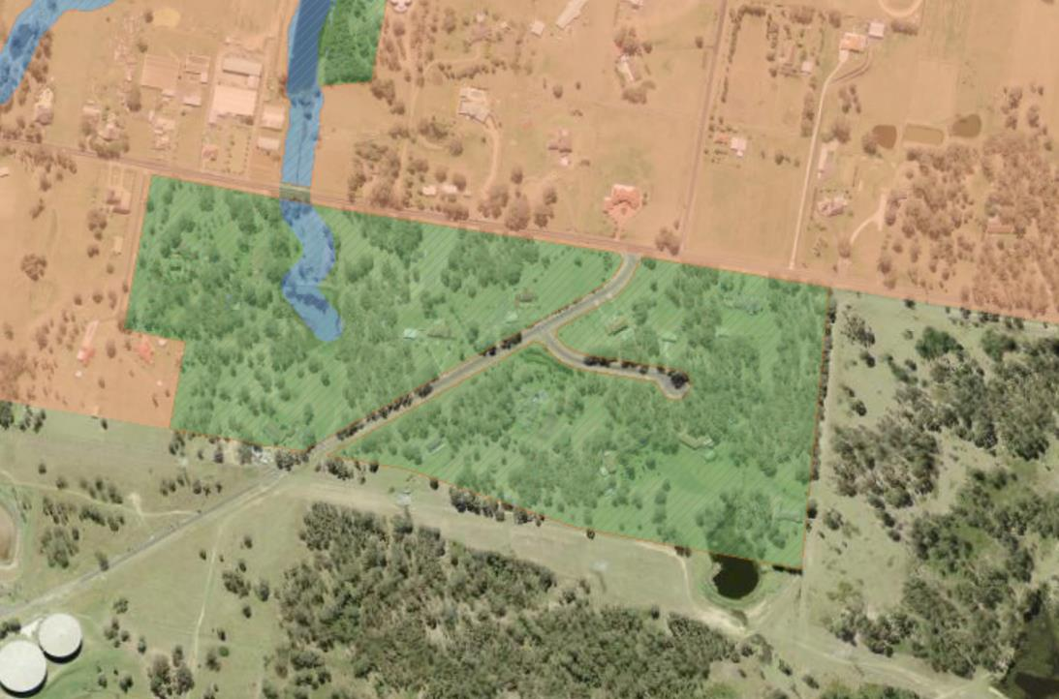

Slide 19
Biodiversity ‘offsetts’
Legal framework for mitigating (limiting) impacts
New Conservation areas for Clearing
New Restoration programs for Degradation
Normal rules
developers set aside new conservation areas for the same ecosystems/species that are harmed
fixed ratios of harm-to-offset
cost is whatever it takes
CPCP
replace this with a ‘strategic’ approach
Developers pay a levy to government (DPIE) who use it to deliver more coordinated mitigation

Slide 20
Biodiversity ‘offsetts’
CPCP talks about three key offsets (reserve investigation areas)
Koala reserve
Additions & tree planting to Gulguer NR
Tree planting at ‘the Confluence’

Slide 21
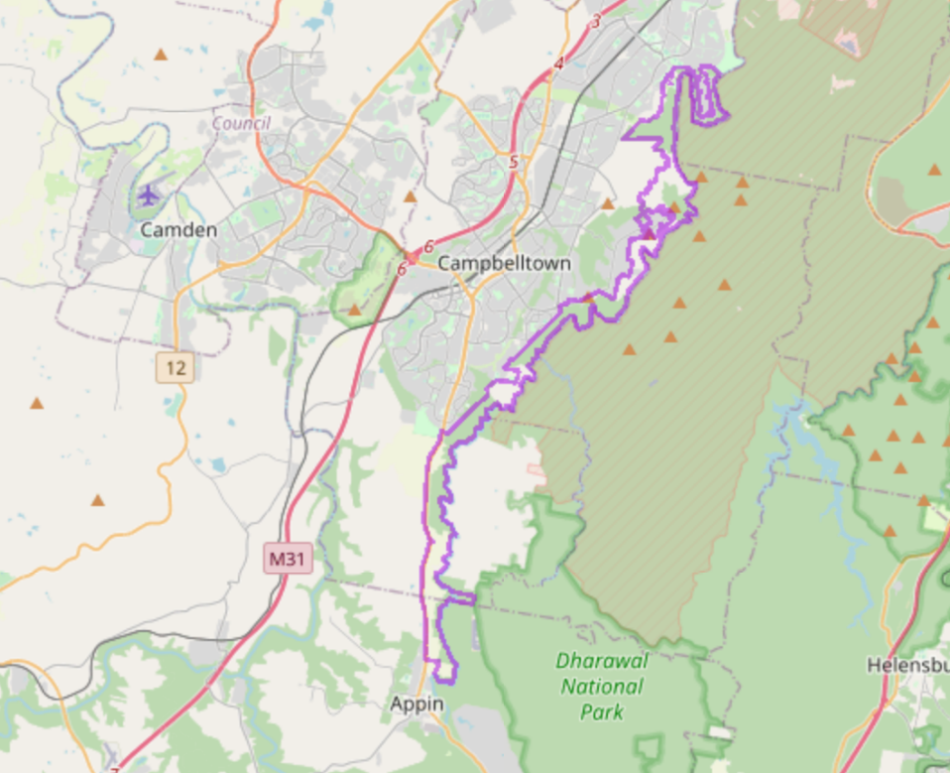
PROPOSED KOALA RESERVE (CROWN LANDS & PRIVATE)

Slide 22
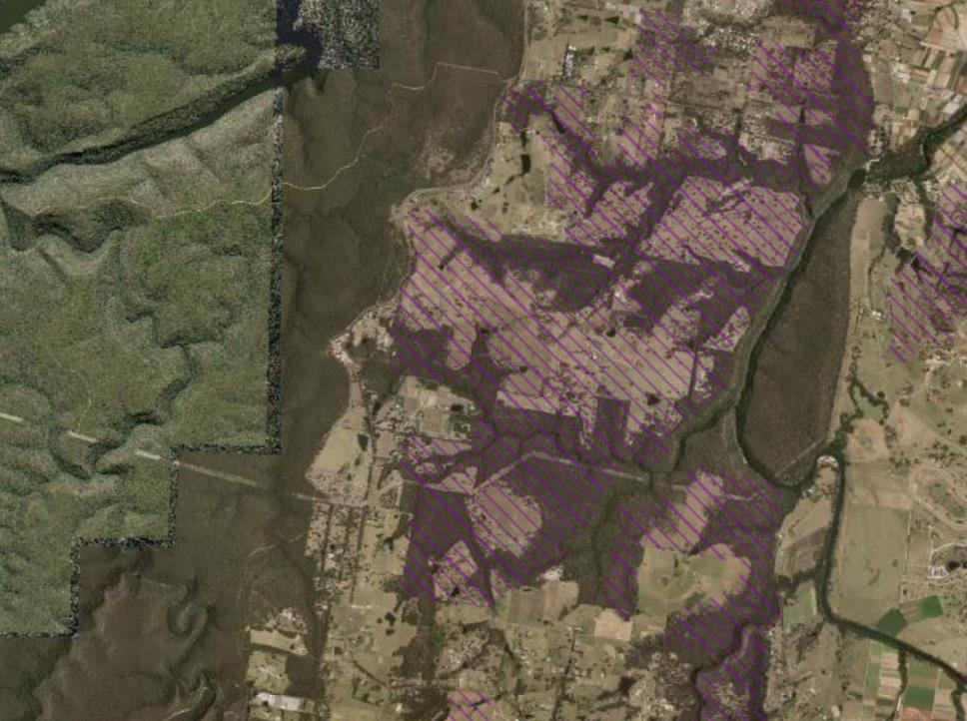
GULGUER – PROPOSED REVEGETATION ON SANDSTONE
‘Any revegetation should not be traded off against the key importance of retaining all existing remnants.’ Auld & Tozer (2004)

Slide 23
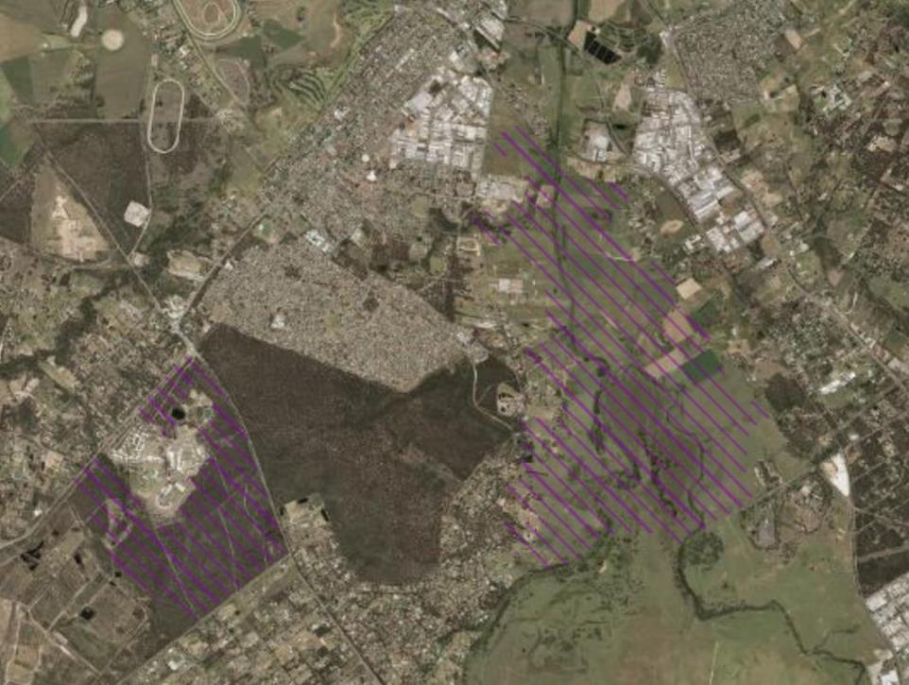
THE CONFLUENCE – PROPOSED REVEGETATION ON FLOODPLAIN
Revegetation in the Cumberland Plain has 40-100% more weeds and less than 10% of the diversity compared to even low-quality remnants (Nichols 2005)

Slide 24
Biodiversity ‘offsetts’
Item | Ecosystem | Outcome
Georges River Koala Reserve | >70% sandstone, minor SSTF | Benefit to local Koala population, although isolated Plan retains flexibility to deliver all, part or none of it Not National Park
Gulguer Additions | >70 sandstone, minor SSTF, exotic grassland | Corridor benefit for sandstone ecosystems
The Confluence | 100% undevelopable exotic grassland on floodplain | gratuity item -developers stuck with undevelopable land

Slide 25
Biodiversity ‘offsets’
They are ideas only
DIRD is requesting to approve the development up-front, and possibly deliver, discretionarily
The 3 Highlights do not relate to the primary requirement
damage is overwhelmingly to Cumberland Plain Woodland – singlehandedly removing 10% of entire ecosystem (1,014 ha)
The Three deliver little to none of the actual offsets required

Slide 26
Changing the way big projects are offset
Precedent – NATIONAL IMPLICATIONS
Replaces safeguards of previous approvals
Development (damage) locked-in but offsets not
Not staged. Staging ensures offsets actually delivered by restricting further stages until conservation delivered
Offset budget not locked-in (tiny initial offering)
Revegetation to displace Conservation
Heavily relies on relabeling existing public land to subsidise developers offset costs

Slide 27
Western Sydney Growth Areas offset program

Slide 28
Farmers & landowners denied conservation
Relabeling & re-funding existing reserves
Particularly local Council reserves
Undercutting credit price – government unable to buy land under threat
Offset credit price is locally at <10% of median land value
Vast private properties willing to conserve Cumberland Plain Woodland, but >50% have pulled out after changes

Slide 29
Strategic benefit or developer hand-out?
Some strategic benefit for Koalas & Gulguer
Extremely strong concerns over failure to lock-in delivery, funding, and oversight
Probably better off with individual developments under existing programs
With major changes it could actually deliver strategic outcomes…

Slide 30
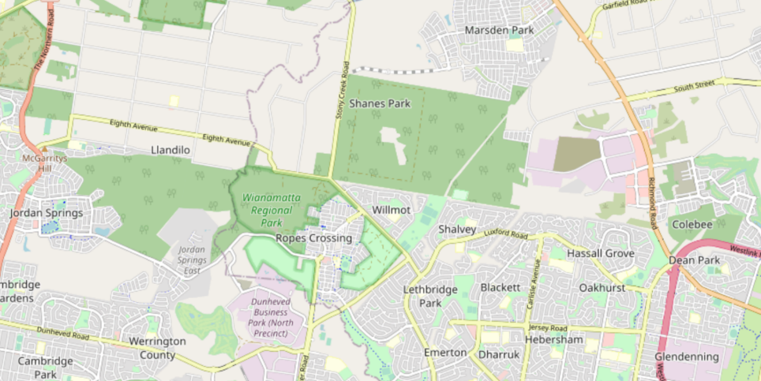

Slide 31
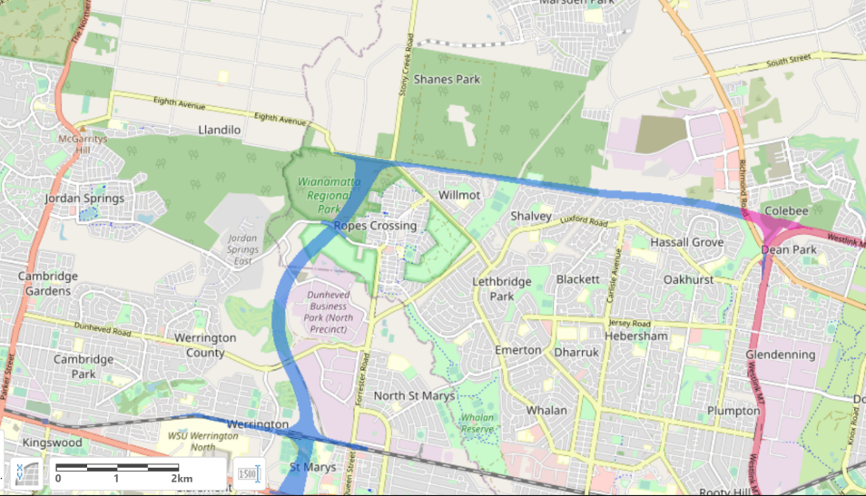

Slide 33
KEY ASKS
KEY CHANGES TO PROPOSED DEVELOPMENTS
Clearing 10% of the entire Cumberland Plain Woodland ecosystem is unacceptable
Protect a 500 m wide koala corridor at Mount Gilead
Tunnel 2 km to save Wianamatta Regional Park
Extend the Camden Tunnel 4 km south and 6 km north - saving EMAI-to-Razorback Wildlife Corridor, Cobbitty Hills & homes

Slide 34
KEY ASKS
KEY CHANGES TO PROPOSED OFFSETS
Protect the Cumberland Conservation Corridor within the Strategic Conservation Area (SCA)
Protest landowner-specific exclusions in the SCA
Scrap E2 zoning (Growth Centre failure) and either pay to conserve or allow to develop (ensure lot sizes viable offsets)

Slide 35
KEY ASKS
OBJECT TO CHANGES TO PROCEDURE & THEIR NATION-WIDE CONSEQUENCES
Adequate Budget locked-in up-front
Staging development to match delivery of offsets
No public land for developers offsets
Conserving what remains, not planting on waste land
No taxpayer subsidy of developer offsets

Slide 36
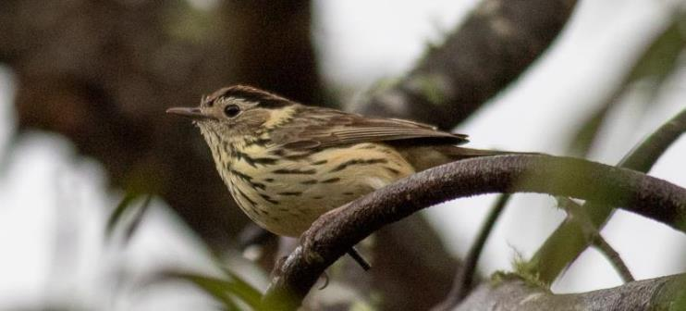
BEING EFFECITVE
Submissions (ignored?)
Pressure on MPs
Media – change the conversation…
© Mark Fuller

